Slide 1

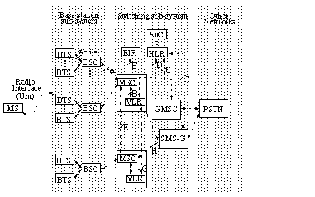
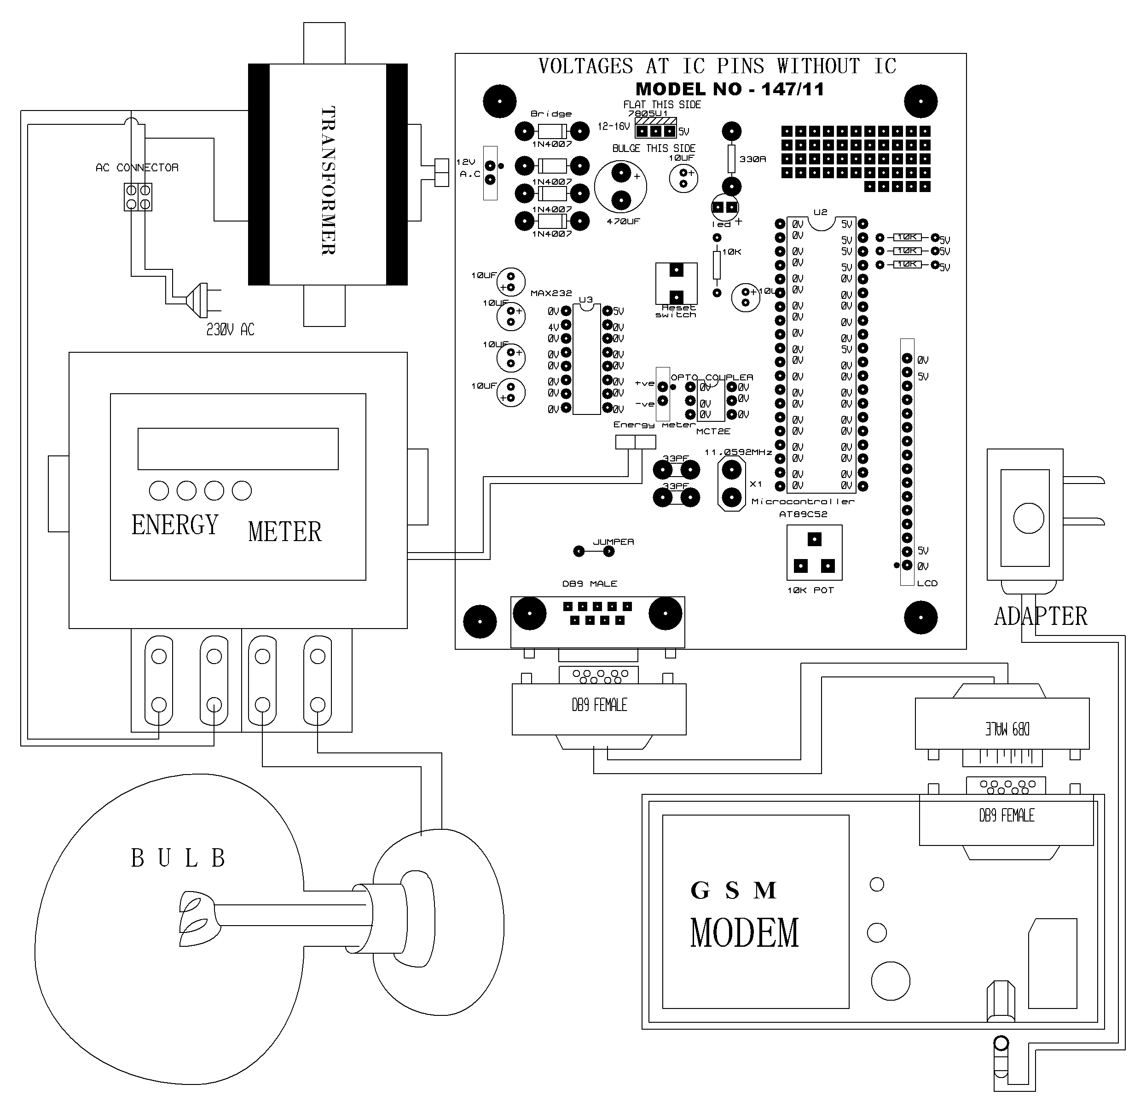
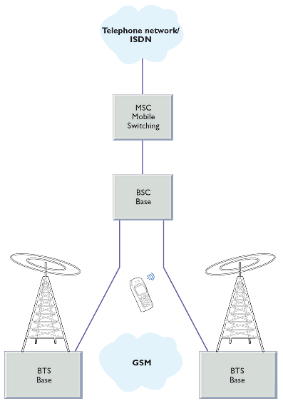
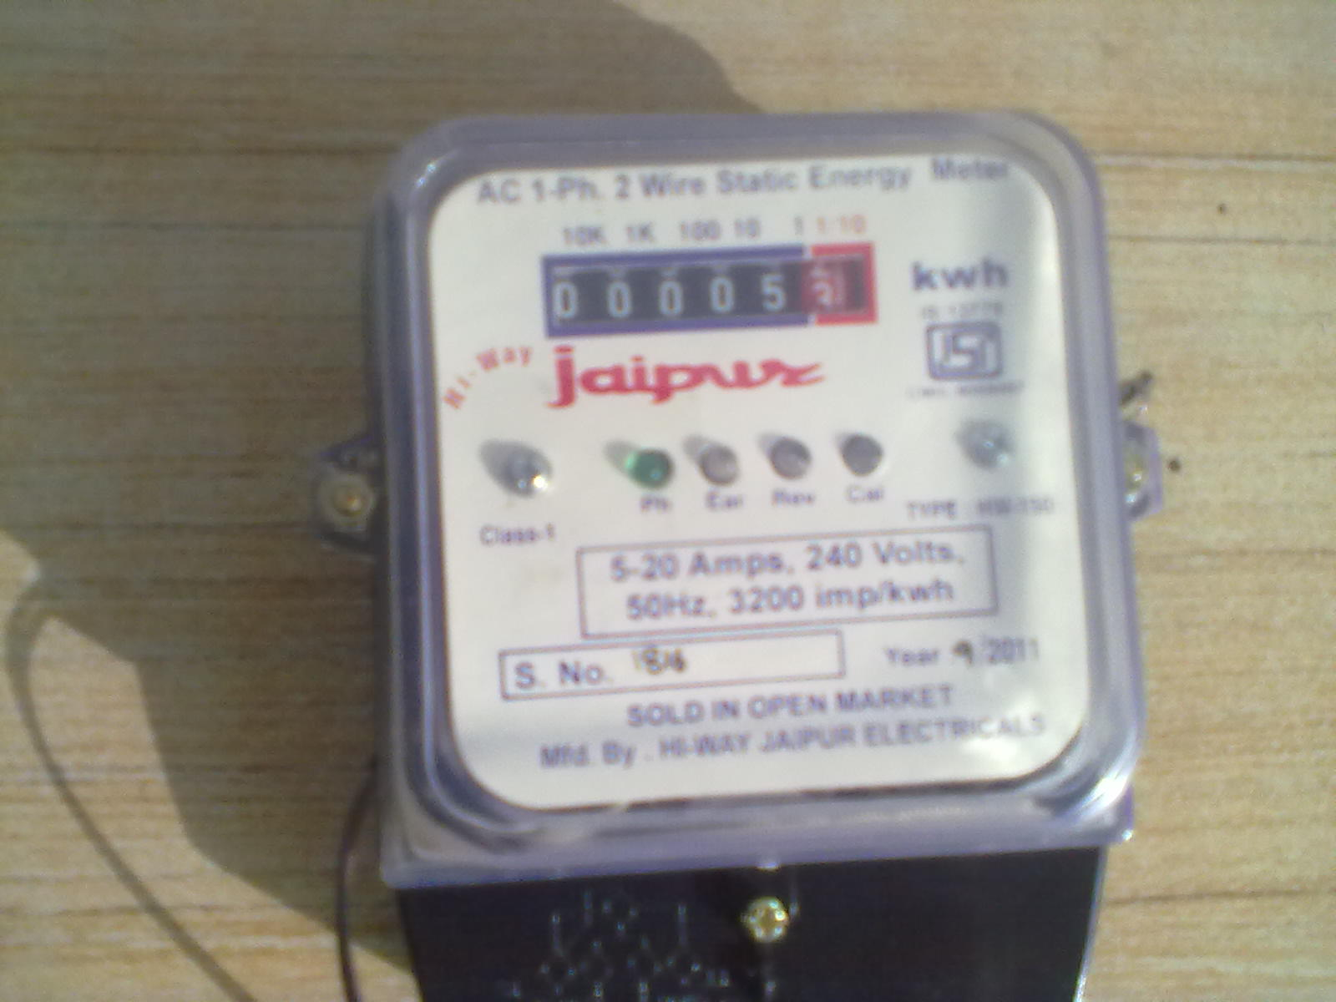
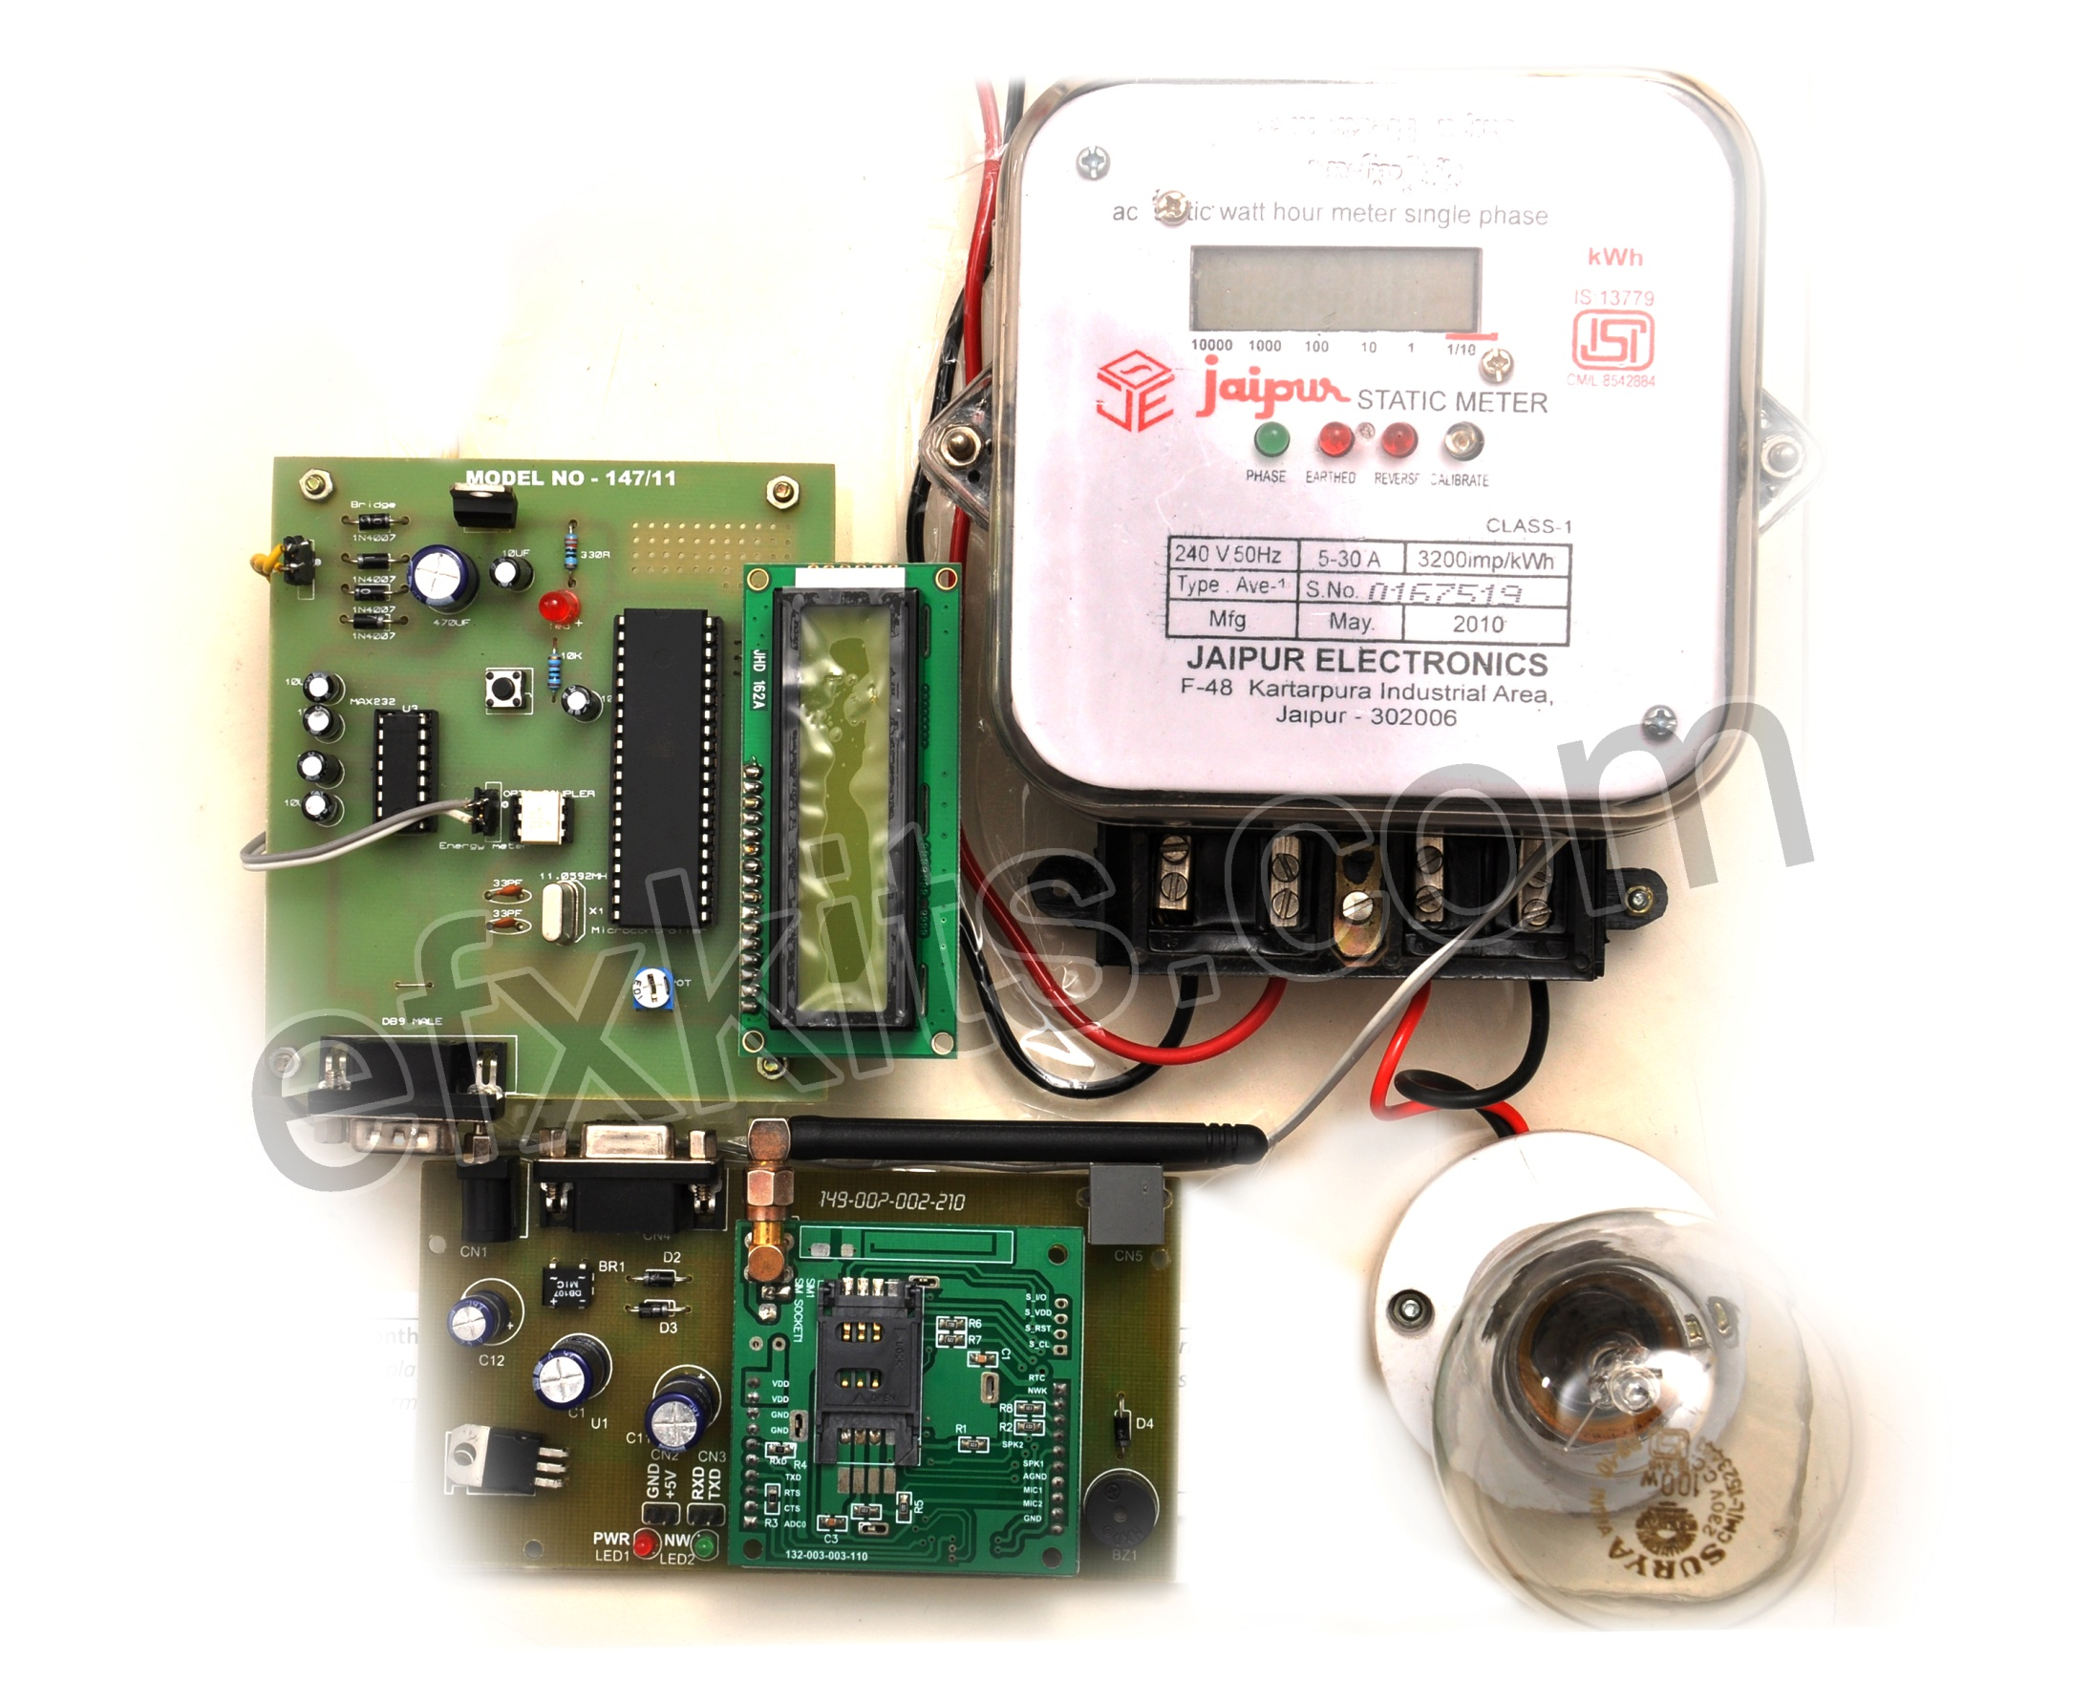
GSM BASED MONTHLY ELECTRICITY ENERGY METER BILLING
WITH DISPLAY TO THE USER
Then the collected meter readings are used for bill calculation. This manual process can become very time consuming and tiresome. It can cause human error and can open an opportunity for corruption done by the human meter reader. Thus the billing system can become inaccurate and inefficient.
Then the collected meter readings are used for bill calculation. This manual process can become very time consuming and tiresome. It can cause human error and can open an opportunity for corruption done by the human meter reader. Thus the billing system can become inaccurate and inefficient.
Then the collected meter readings are used for bill calculation. This manual process can become very time consuming and tiresome. It can cause human error and can open an opportunity for corruption done by the human meter reader. Thus the billing system can become inaccurate and inefficient.
Then the collected meter readings are used for bill calculation. This manual process can become very time consuming and tiresome. It can cause human error and can open an opportunity for corruption done by the human meter reader. Thus the billing system can become inaccurate and inefficient.
Then the collected meter readings are used for bill calculation. This manual process can become very time consuming and tiresome. It can cause human error and can open an opportunity for corruption done by the human meter reader. Thus the billing system can become inaccurate and inefficient.
Electrical Power has become indispensable to human survival and progress. Increasing gap between demand and supply made every other nation explore ways and means to enhance Power Generation capabilities from both conventional and non-conventional means.
Apart from efforts to meet growing demand, mounting AT&C losses in distribution is another challenge being faced by utilities world wide. Specifically developing countries owe to lack of proper energy accounting from infrastructural, technological shortfalls and manual interventions in energy billing.
In the wake of technology upgradation and automation in the Energy Distribution, Automated Meter Reading (AMR) or Meter Data Acquisition and Management assumes importance in enabling the utilities to gather business and operational intelligence, through collection of base line data to analysis, monitor and manage operations in AT&C losses reduction.
Electrical Power has become indispensable to human survival and progress. Increasing gap between demand and supply made every other nation explore ways and means to enhance Power Generation capabilities from both conventional and non-conventional means.
Apart from efforts to meet growing demand, mounting AT&C losses in distribution is another challenge being faced by utilities world wide. Specifically developing countries owe to lack of proper energy accounting from infrastructural, technological shortfalls and manual interventions in energy billing.
In the wake of technology upgradation and automation in the Energy Distribution, Automated Meter Reading (AMR) or Meter Data Acquisition and Management assumes importance in enabling the utilities to gather business and operational intelligence, through collection of base line data to analysis, monitor and manage operations in AT&C losses reduction.
Electrical Power has become indispensable to human survival and progress. Increasing gap between demand and supply made every other nation explore ways and means to enhance Power Generation capabilities from both conventional and non-conventional means.
Apart from efforts to meet growing demand, mounting AT&C losses in distribution is another challenge being faced by utilities world wide. Specifically developing countries owe to lack of proper energy accounting from infrastructural, technological shortfalls and manual interventions in energy billing.
Kirit,Ankit & Chirag [Guided By:-M S DINATH]
A.Y.DADABHAI TECHNICAL INSTITUTE , KOSAMBA
[electrical department]
abstract
Methods or working in old system
Innovative work in new system
Conclusion
The main objective of the project is to develop a wireless energy meter. The microcontroller takes the reading from the energy meter and displays the reading on the LCD. The reading of the energy meter is also sent to the cell phone of the user by a message through GSM modem. This project is powered by an on-board power supply takes the ac power and converts it into dc power that is fed to on-board devices and integrated circuits.
Automatic Meter Reading (AMR) is a state-of-the art technology for reading electric, gas or water meter readings automatically from a remote place without any human intervention. Remote metering promises fast and accurate billing system. In this I D P, a technique for remotely reading electricity meter readings using Short Message Service (SMS) has been illustrated. Existing Global System for Mobile Communications (GSM) networks have been used for sending and receiving SMS.A prototype of the system has been designed and developed for system exploration and experiment.
Many electricity customers are installing their own electricity generating equipment, whether for reasons of economy, redundancy or environmental reasons. When a customer is generating more electricity than required for his own use, the surplus may be exported back to the power grid. Customers that generate back into the "grid" usually must have special equipment and/or safety devices to protect the grid components (as well as the customer's own) in case of faults (electrical short circuits) or maintenance of the grid (say voltage potential on a downed line going into an exporting customers facility).
This exported energy may be accounted for in the simplest case by the meter running backwards during periods of net export, thus reducing the customer's recorded energy usage by the amount exported. This in effect results in the customer being paid for his/her exports at the full retail price of electricity. Unless equipped with a detent or equivalent, a standard meter will accurately record power flow in each direction by simply running backwards when power is exported. Such meters are no longer legal in the UK[dubious – discuss][citation needed] but instead a meter capable of separately measuring imported and exported energy is required. Where allowed by law, utilities maintain a profitable margin between the price of energy delivered to the consumer and the rate credited for consumer-generated energy that flows back to the grid. Lately, upload sources typically originate from renewable sources (e.g., wind turbines, photovoltaic cells), or gas or steam turbines, which are often found in cogeneration systems. Another potential upload source that has been proposed is plug-in hybrid car batteries (vehicle-to-grid power systems). This requires a "smart grid," which includes meters that measure electricity via communication networks that require remote control and give customers timing and pricing options. Vehicle-to-grid systems could be installed at workplace parking lots and garages and at park and rides and could help drivers charge their batteries at home at night when off-peak power prices are cheaper, and receive bill crediting for selling excess electricity back to the grid during high-demand hours.
The recent advances in the field of information technology have made the exchange of information fast, secured and accurate. The digital revolution caused the rapid drop of digital devices such as computers and telecommunication devices. Communication networks like the internet, GSM networks, etc. are available almost all the countries of the world. In the work presented here, a technique has been developed to read electricity meter readings from a remote server automatically using the existing GSM networks for cellular phones. This technique can be applied for gas or water meters as well. The meters send the meter readings like kilo-watt-hour (kWh), voltage, current, bill, etc. by SMS to a central server. The central server then stores the information in database for analysis and sends the bill to the customer by e-mail. Prepaid scratch-card based billing scheme can also be implemented.
The SMS based data collection can be done very quickly and efficiently. Data can be collected after any desired time interval such as hourly, daily, weekly, or monthly basis. As there is no human intervention in the entire process, there is no chance of human error and corruption. Also, unwanted weather conditions like heavy snow, rain, storm, etc. will not hamper on collecting data as long as the GSM networks are stable.
By using our project we can conclude that human error are neglected and given accurate reading on display by user through the GSM modem……
Electrical Power has become indispensable to human survival and progress. Increasing gap between demand and supply made every other nation explore ways and means to enhance Power Generation capabilities from both conventional and non-conventional means.
Apart from efforts to meet growing demand, mounting AT&C losses in distribution is another challenge being faced by utilities world wide. Specifically developing countries owe to lack of proper energy accounting from infrastructural, technological shortfalls and manual interventions in energy billing.
Introduction & define Problem
Future Enhancement
With help of GSM based energy meter one can see the reading within few seconds by sending one message. Specially in rainy season it can be very useful because just scratching the card we can pay the bill on time .
The conventional billing system for electricity, gas, or water is that an assigned person visits each house and read the meter readings manually. Then the collected meter readings are used for bill calculation. This manual process can become very time consuming and tiresome. It can cause human error and can open an opportunity for corruption done by the human meter reader. Thus the billing system can become inaccurate and inefficient.
The recent advances in the field of information technology have made the exchange of information fast, secured and accurate. The digital revolution caused the rapid drop of digital devices such as computers and telecommunication devices. Communication networks like the internet, GSM networks, etc. are available almost all the countries of the world. In the work presented here, a technique has been developed to read electricity meter readings from a remote server automatically using the existing GSM networks for cellular phones. This technique can be applied for gas or water meters as well. The meters send the meter readings like kilo-watt-hour (kWh), voltage, current, bill, etc. by SMS to a central server. The central server then stores the information in database for analysis and sends the bill to the customer by e-mail. Prepaid scratch-card based billing scheme can also be implemented.
The SMS based data collection can be done very quickly and efficiently. Data can be collected after any desired time interval such as hourly, daily, weekly, or monthly basis. As there is no human intervention in the entire process, there is no chance of human error and corruption. Also, unwanted weather conditions like heavy snow, rain, storm, etc. will not hamper on collecting data as long as the GSM networks are stable.
Acknowledgement or contact or reference
Mr. M M DALCHAVAL (principle of A Y DADABHAI TECHNICAL INSTITUTE)
Mr. M S DINATH (HOD OF ELECTRICAL DEPARTMENT)
“The 8051 Microcontroller and Embedded systems” by Muhammad Ali Mazidi and Janice Gillispie Mazidi , Pearson Education.
ATMEL 89S52 Data Sheets
www.howstuffworks.com

